Slide 1


Marathwada Mitra mandal’s
COLLEGE OF ENGINEERING
Karvenagar, Pune
An Autonomous Institute
Presentation
On
COURSE REGISTRATION SYSTEM

Slide 2
Group Information
Sr.No | Prn No | Name of students
1) | B24IT1001 | HARSH PANKAJ KURHE
2) | B24IT1016 | NISHANT AMBADKAR
3) | B24IT1055 | SHIVAM MANDHANI

Slide 3
Outline:
Introduction
Research
Analysis
Ideate
Build
Test
Implement
Links
reference

Slide 4

Course Registration System
Welcome to the presentation on the Course Registration System, a comprehensive platform designed to streamline the course registration process for students and institutions.

Slide 5
Introduction to the Course Registration System
The Course Registration System is a user-friendly online platform designed to automate the registration process, eliminating the need for manual forms and paper-based applications. It provides a centralized platform for managing student accounts, course catalogs, registration deadlines, and enrollment statuses.
Streamlined Process
Enhanced Efficiency
The system simplifies the registration process by automating key steps like course selection, enrollment, and payment. It also ensures that all registration data is stored securely and accessible to authorized personnel.
The system improves operational efficiency by eliminating manual tasks, reducing errors, and providing real-time insights into registration trends and enrollment patterns.

Slide 6
Key Features of the System
The Course Registration System offers a wide array of features designed to meet the diverse needs of students, instructors, and administrators.
1
Comprehensive Course Catalog
2
Student Accounts
The system provides a comprehensive course catalog, enabling students to browse through available courses, filter options based on their interests, and view detailed information about each course, including course descriptions, prerequisites, and instructor details.
Students can create secure accounts, manage their personal information, view their registration history, and access course materials online.
3
Enrollment Tracking
The system allows instructors to track student enrollment, monitor attendance, and submit grades, fostering a smooth academic flow for both students and instructors.

Slide 7



Student Registration Process
The student registration process is designed to be intuitive and user-friendly, enabling students to complete their registration swiftly and efficiently.
Account Creation
Students begin by creating an account, providing their personal details, and setting a secure password.
Course Selection
Students can browse the course catalog, search for specific courses, and add their desired courses to their cart.
Enrollment Confirmation
Once the student confirms their course selections, the system verifies course availability, checks prerequisites, and guides the student through the enrollment process.

Slide 8
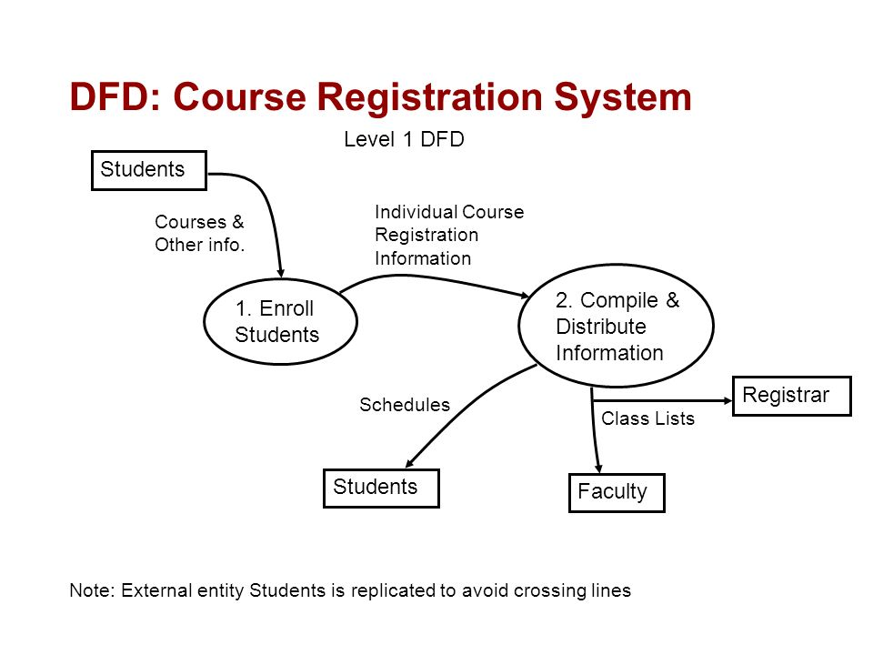
Course Enrollment Workflow
The system manages the course enrollment workflow to ensure a seamless and efficient experience for both students and instructors.
Enrollment Request
1
Students submit their enrollment requests, which are then routed to the system for processing.
2
System Verification
The system automatically verifies course availability, prerequisites, and any other enrollment criteria.
3
Enrollment Confirmation
Upon successful verification, students receive enrollment confirmation, granting them access to course materials and related resources.

Slide 9
Course Capacity Management
The Course Registration System includes robust capacity management features to ensure that course enrollment adheres to predefined limits and that resources are allocated effectively.3
Course Capacity Limits
Waitlist Management
Automated Notifications
Each course has a defined maximum capacity, preventing overenrollment and ensuring that available resources can accommodate all enrolled students.
When courses reach their capacity, students can be added to a waitlist, ensuring that they are notified if a spot becomes available.
Students and instructors receive automated notifications regarding enrollment updates, course changes, and any relevant announcements.

Slide 10

Reporting and Analytics
The system provides comprehensive reporting and analytics capabilities, empowering administrators to monitor registration trends, analyze enrollment data, and identify areas for improvement.
100%
Real-time Data
Access real-time data on registration trends, enrollment patterns, and course popularity.
95%
Custom Reports
Generate customized reports on specific courses, student demographics, and registration timelines.
80%
Trend Analysis
Identify emerging trends in course selection, enrollment, and student behavior.

Slide 11




Conclusion and Next Steps
The Course Registration System is a powerful tool for streamlining the registration process, improving operational efficiency, and fostering a positive learning environment. As we move forward, we will continue to enhance the system by incorporating new features, integrating with existing campus systems, and tailoring it to the specific needs of our students, instructors, and administrators.
Streamlined Registration
Enhanced Efficiency
Data-Driven Insights
Provides a streamlined and efficient registration process for students.
Improves operational efficiency for administrators and instructors.
Offers comprehensive reporting and analytics capabilities.

Slide 12
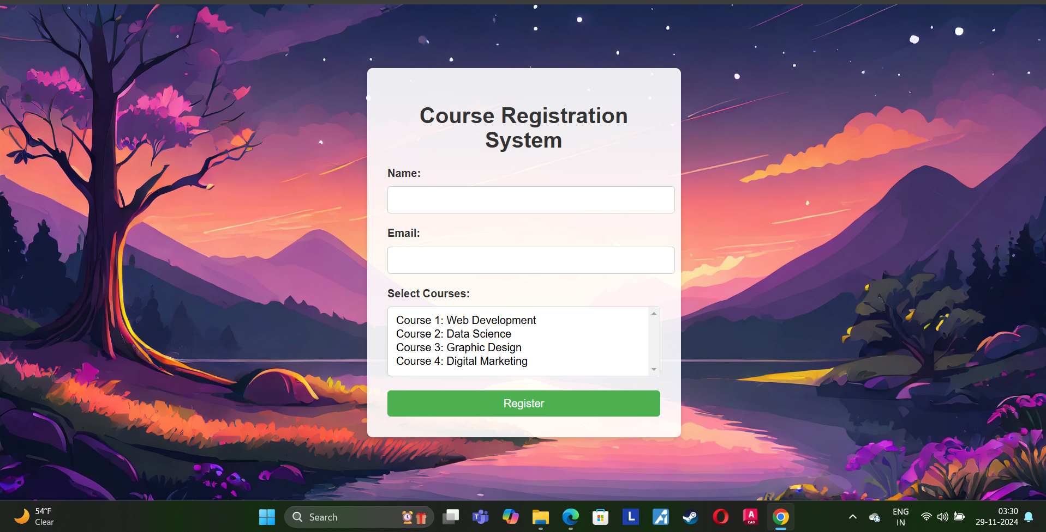
IMPLEMENT:

Slide 13


Software requirements
1) Compiler like Gcc
2) VS Code
Hardware requirements
Operating system 64 bit windows or higher operating system .
RAM Minimum of 8GB.

Slide 14
Links
1.Upload Video Link Here –
2.Upload Blog Link here –
3. Upload Project Link here (Github link) –
Nishant Ambadkar – GITMASTER904/Mini_Project_1: Course Registration System
Harsh Khure –
Shivam M

Slide 15
Reference
Ex.
[1] w3schools.com
[2] Online Links
[3] video links

